Slide 1



LECTURE-1
CSE-4721
SOFTWARE ENGINEERING

Slide 2
Overview
Computer software is the product that designed and built by software engineers.
Software is used by virtually everyone in society.
Software engineers have a moral obligation to build reliable software that does no harm to other people.
Software engineers view computer software, as being made up of the programs, documents, and data required to design and build the system.
Software users are only concerned with whether or not software products meet their expectations and make their tasks easier to complete.

Slide 3
HOW SHOULD WE DEFINE SOFTWARE ?
A textbook description of software might take the following form: Software is (1) instructions (computer programs) that when executed provide desired function and performance, (2) data structures that enable the programs to adequately manipulate information, and (3)documents that describe the operation and use of the programs. There is no question that other, more complete definitions could be offered. But we need more than a formal definition.

Slide 4
SOFTWARE CHARACTERISTICS
Software
Software is both a product and a vehicle for developing a product.
Software is engineered not manufactured.
Software does not wear out, but it does deteriorate.
Currently, most software is still custom-built.

Slide 5
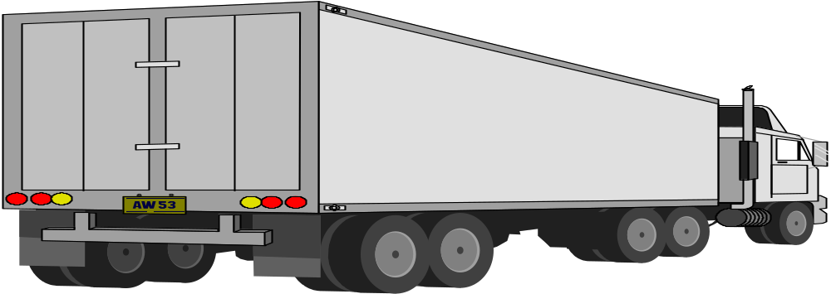
Produces
Information
Modifies
Manages
Displays
Acquires
Software - the Product
Transforms
Software
Vehicle to deliver the product
Operating System
Network Software
Case tools

Slide 6
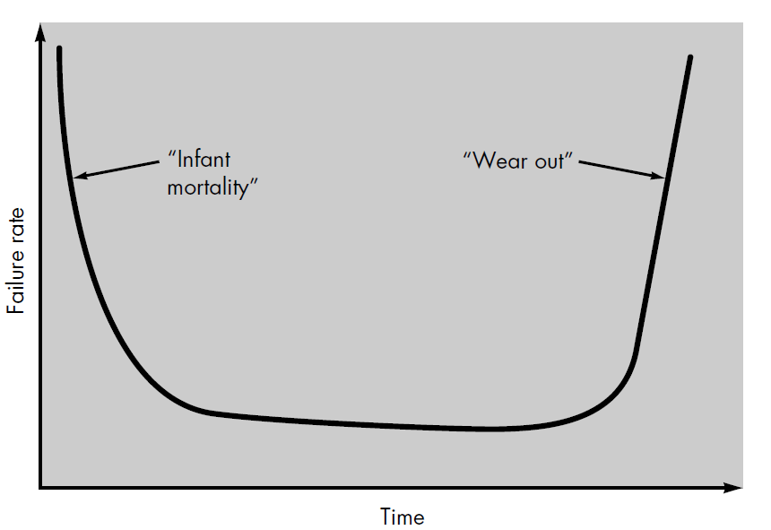
Failure curve for hardware

Slide 7
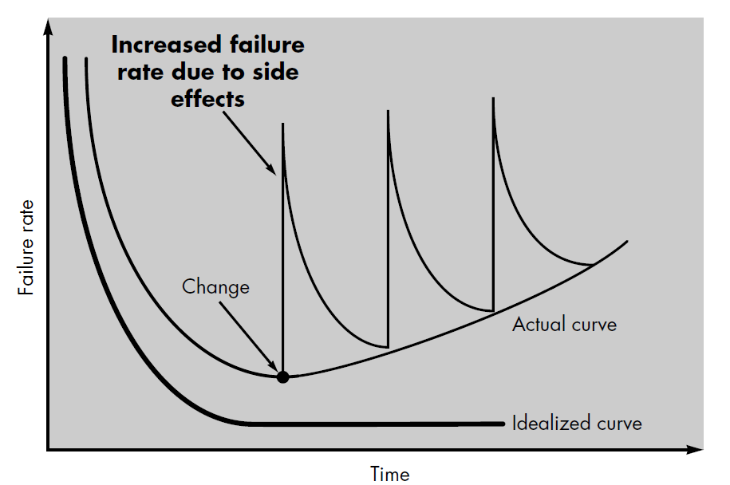
Idealized and actual failure curves for software

Slide 8
Software application
System Software
Real time software
Scientific area are moving away from conventional numerical algorithms . Computer-aided design , system simulation , and other interactive applications have begun to take on real time and even system software characteristic.
Business software
Word processing , spreadsheets , computer graphics , multimedia , entertainment , database management , personal and bussiness financial applications , external network.
Expert systems , Knowledge based systems , pattern recognition (image and voice),artificial neural networks, theorem proving , and game playing.
Compilers, editors, and file management utilities ,operating system components , drivers , telecommunications processors
Software that monitors/analyzes/controls real-world events as they occur is called real time
Payroll , accounts receivable/payable , inventory,MIS , Point of sale transaction processing
Keypad control for microwave oven , Digital functions in an automobile such as fuel control , dashboard displays, and braking systems
HTML,Perl, or Java and data hypertext and a variety of visual and audio formats
Engineering and scientific software
Embedded software
Personal computer software
Web-based software
Artificial intelligence software.

Slide 9
THE END

